Slide 1
Building a computer for your needs
by Anastasiya Brovchenko
Group IO-64, FICT

Slide 2
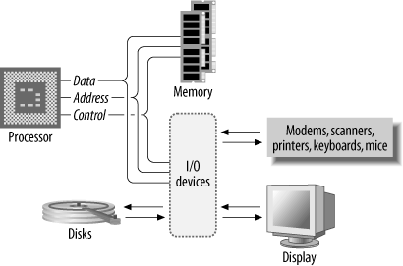
Basic computer system

Slide 3
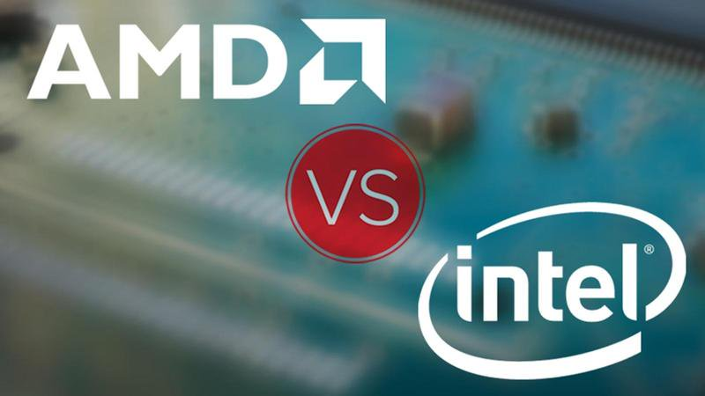
increasing the number of cores
increasing multi-threaded performance
higher сlосk spееds
low number of cores

Slide 4
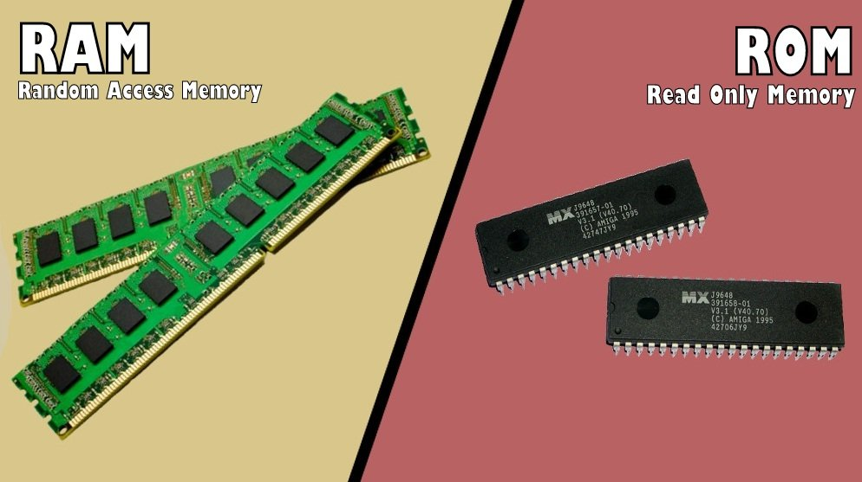

Slide 5
HDD
SSD
Cheaper
More capacity
More slower
Fragmented
A lot of noise
More expensive
Less capacity
More faster
More safe
Quiet

Slide 6
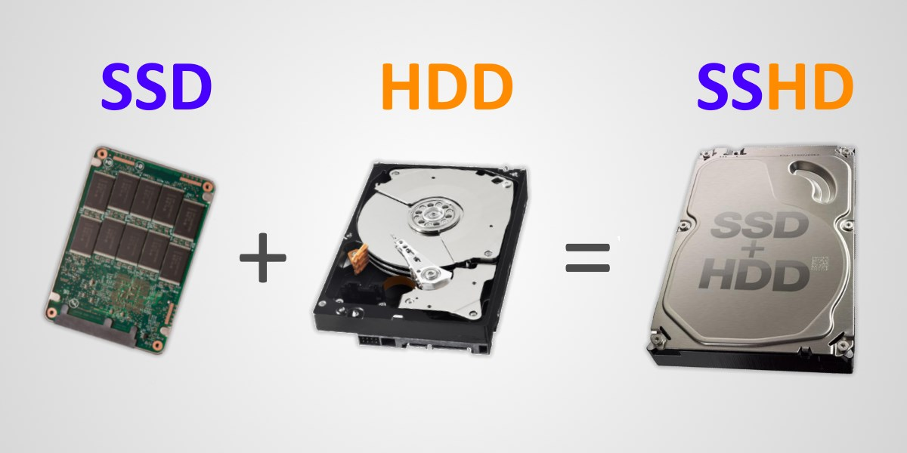

Slide 7
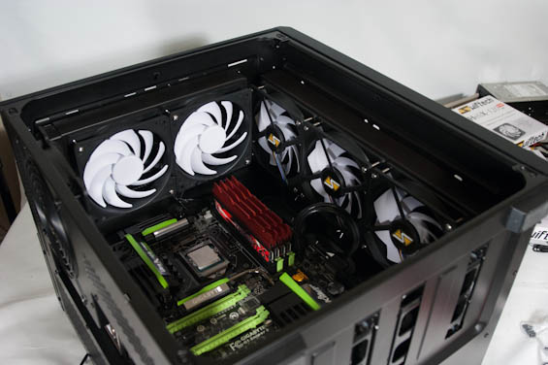
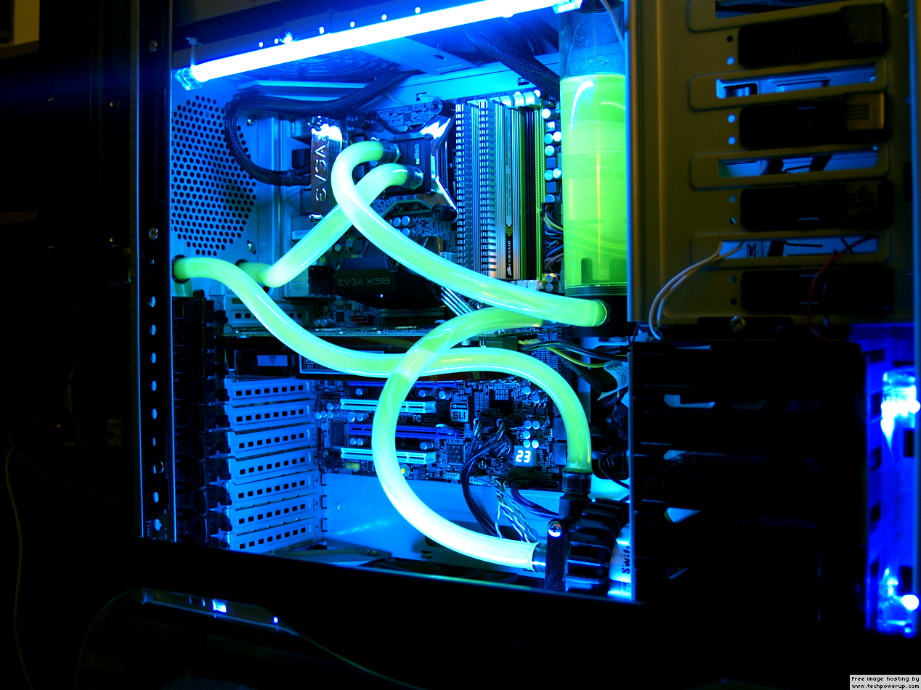
Air cooling vs. Liquid cooling

Slide 8
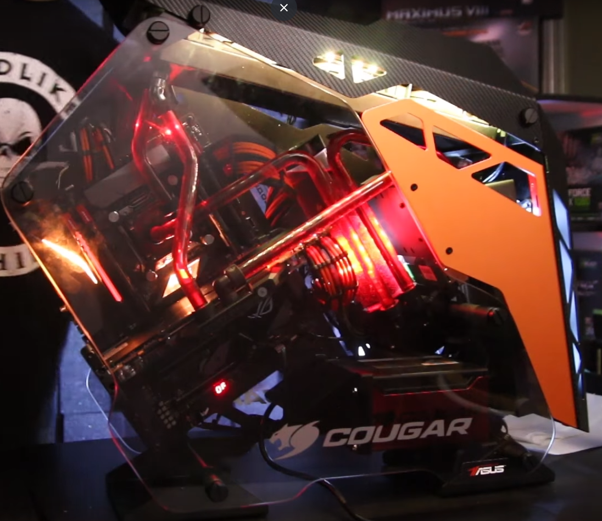
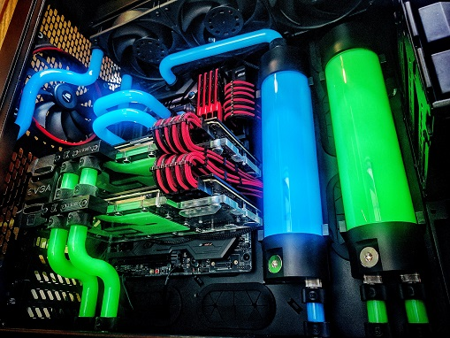
Liquid cooling
Cramped computer cases
Extreme overclocking

